Slide 1
NETWORKING & INFRASTRUCTURES PROJECT
GROUP 4
JUMALE ABDI
SULEIMAN USAMA
INNOCENT KISOKA

Slide 2
Table of contents
INTRODUCTION
PROJECT SCOPE
NETWORK REQUIREMENTS
PROJECT DESIGN
IP NETWORK DESIGN TABLE
NETWORK TOPOLOGY DIAGRAM WITH IP ADDRESSES
NETWORK TESTING AND VERIFICATION PROCEDURE

Slide 3
INTRODUCTION
Our project is to design a reliable network system for company Phantom Dynasty which has four branches located in different cities. LA, Boston, New York, and Texas.
Each branches have four departments.
The Departments
Marketing
Sales
IT
Accounting
Each department has a total of 10 PC’s excluding the LA branch having on 5 PC’s per department

Slide 4
PROJECT SCOPE
Is to design a network that connects the four branches in each city.
Configuring used network devices using assigned IP address 192.168.4.0 so that all four branches can communicate with each other and share resources efficiently.
Network requirement
20 switches
4 routers
140 PCS
Serial DTE
Cross-over cables
Straight -through cables

Slide 5
PROJECT DESIGN
Physical Design
Our project is physically designed to represent Phantom Dynasty’s network structure in four cities.
Each department connects all the Pcs to a switch using a copper straight through cable in star topology. The departments are then connected to each other for communication to another switch via copper cross over then is connected to a router using copper straight through.

Slide 6
Physical Design CONT’D
This is done to the four branches and therefore a connection is brought to reality by connecting all the four routers to each other by introducing a WIC-2T to enable connection of more than one serial connection

Slide 7
Logical Design
We set up an IP address 192.168.4.0 as the network address for the company. The IP was subnetted to a total of three subnets address to ease up the network, 255.255.255.240, 255.255.255.248, 255.255.255.252.

Slide 8
Logical Design CONT’D
After looking at the total number of hosts, we decided to adopt this approach as:
For the three cities(New York, Boston and Texas) we had a total of 12 subnets which hosted 14 hosts per subnet
For the Los Angeles, we had a total of 4 subnets which hosted 6 hosts per subnet
For the last IP address, we decided to leave it for the routing thus had a total of 4 subnets which hosted 2 hosts per subnet
This left a total 3 subnets thus allowing leeway for the expansion of the company’s network

Slide 9
SUBN ET | NETWROK ADDRESS | FIRST IP ADDRESS | LAST IP ADDRESS | BROADCAS T ADDRESS | SUBN ET MASK | NUMB ER OF HOST
New York | 192.168.4.0 | 192.168.4.2 | 192.168.4.6 2 | 192.168.4.6 3 | /26 | 40
Boston | 192.168.4.6 4 | 192.168.4.6 6 | 192.168.4.1 26 | 192.168.4.1 27 | /26 | 40
Texas | 192.168.4.1 28 | 192.168.4.1 30 | 192.168.4.1 90 | 192.168.4.1 91 | /26 | 40
L.A | 192.168.19 2 | 192.168.4.1 94 | 192.168.4.2 22 | 192.168.4.2 23 | /27 | 20
Router 1&2 | 192.168.4.2 24 | 192.168.4.2 26 | 192.168.4.2 26 | 192.168.4.2 27 | /30 | 2
Router 2&3 | 192.168.4.2 28 | 192.168.4.2 30 | 192.168.4.2 30 | 192.168.4.2 31 | /30 | 2
Router 3&4 | 192.168.4.2 32 | 192.168.4.2 34 | 192.168.4.2 34 | 192.168.4.2 35 | /30 | 2
Router 4&1 | 192.168.4.236 | 192.168.4.237 | 192.168.4.238 | 192.168.4.239 | /30 | 2

Slide 10
The number of subnets
The total number of Subnets are 8

Slide 11
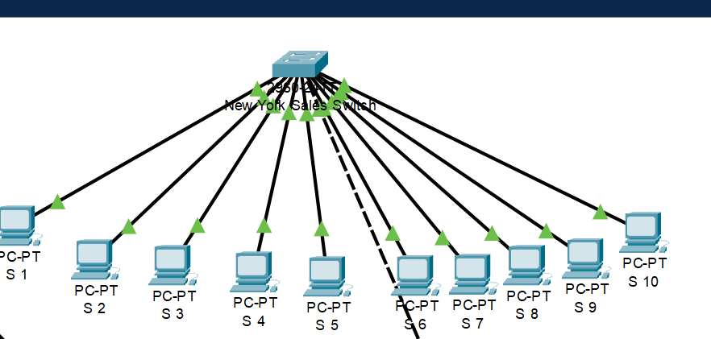
TOPOLOGIES
Departmental topology

Slide 12
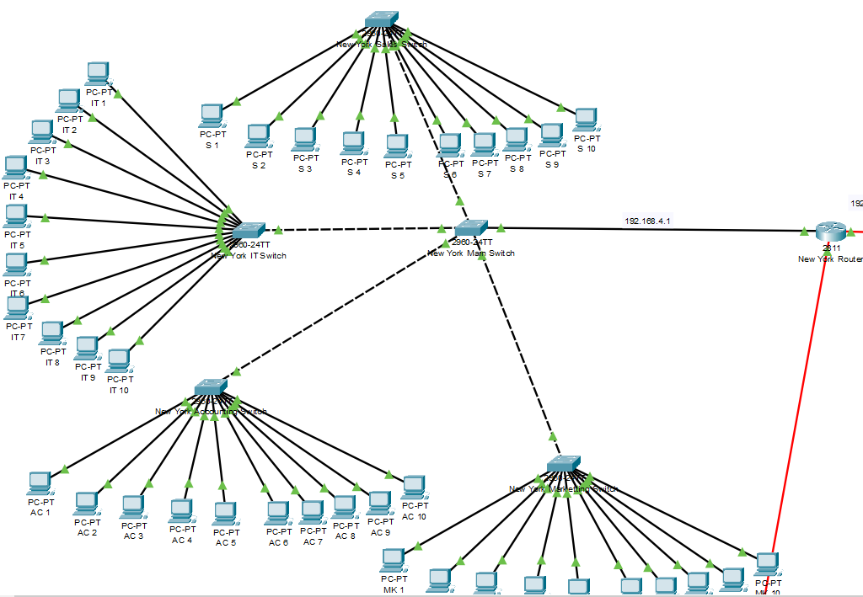
Branch Topology

Slide 13
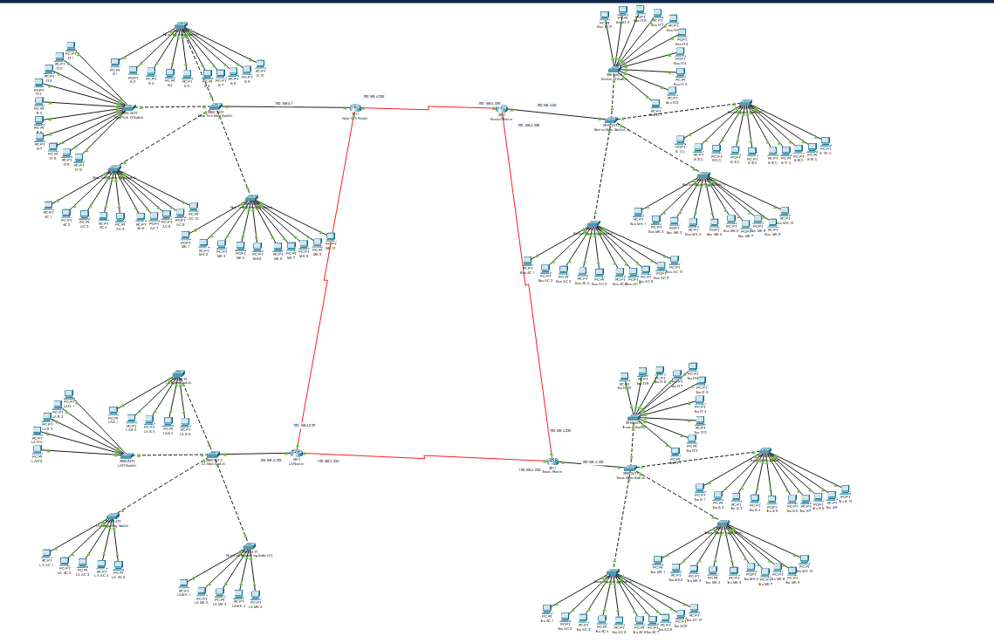
Wide Area Network Topology

Slide 14
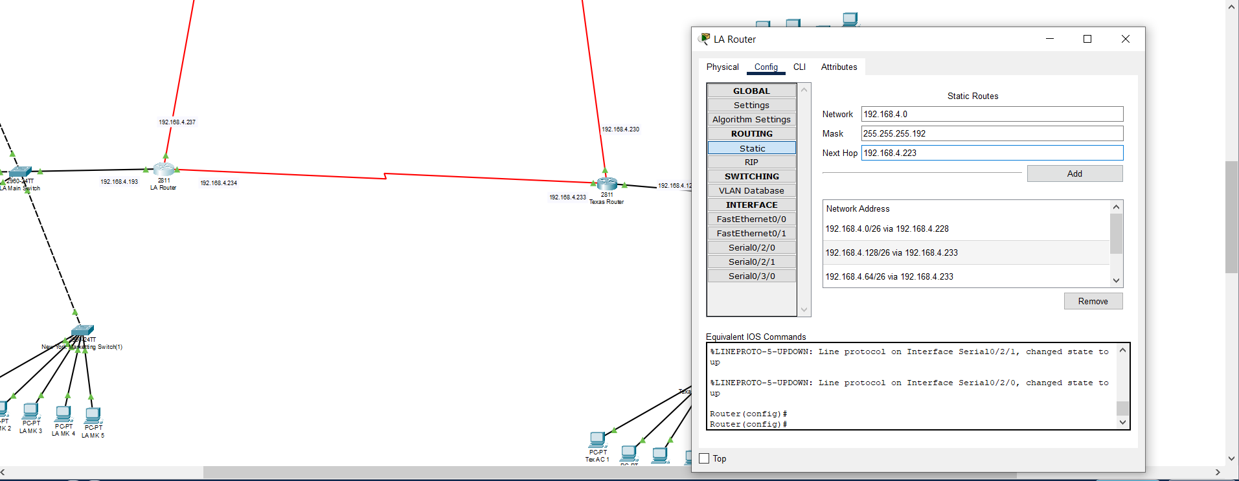
STATIC ROUTING

Slide 15
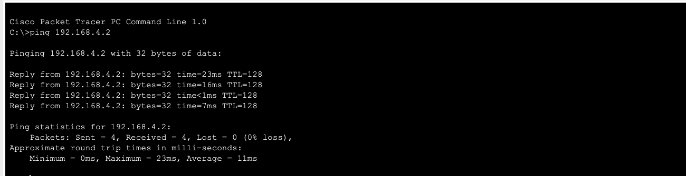
Test and Verification

